Slide 1
Being agile with modern Java

Slide 2
Being agile?

Slide 3
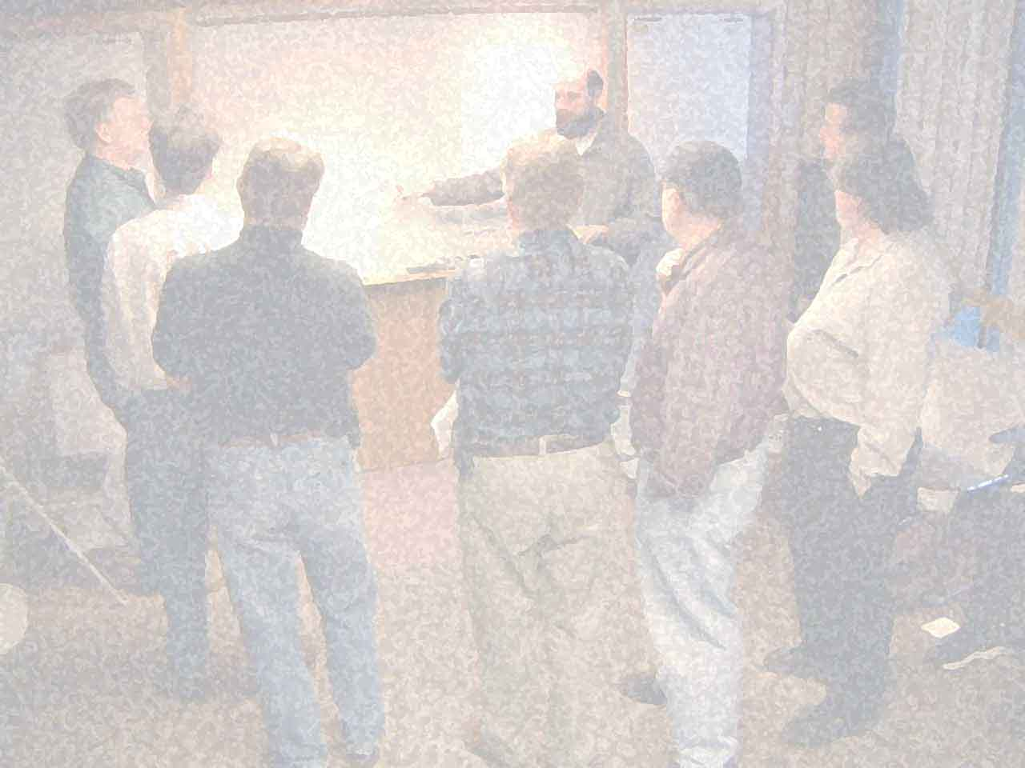

Slide 4
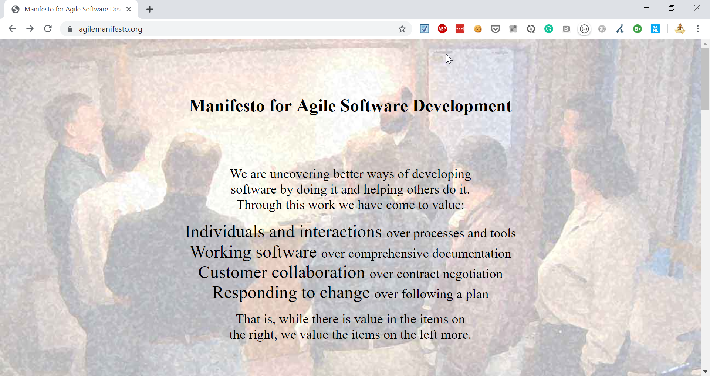

Slide 5






(at that time…)
PROBLEMS

Slide 6
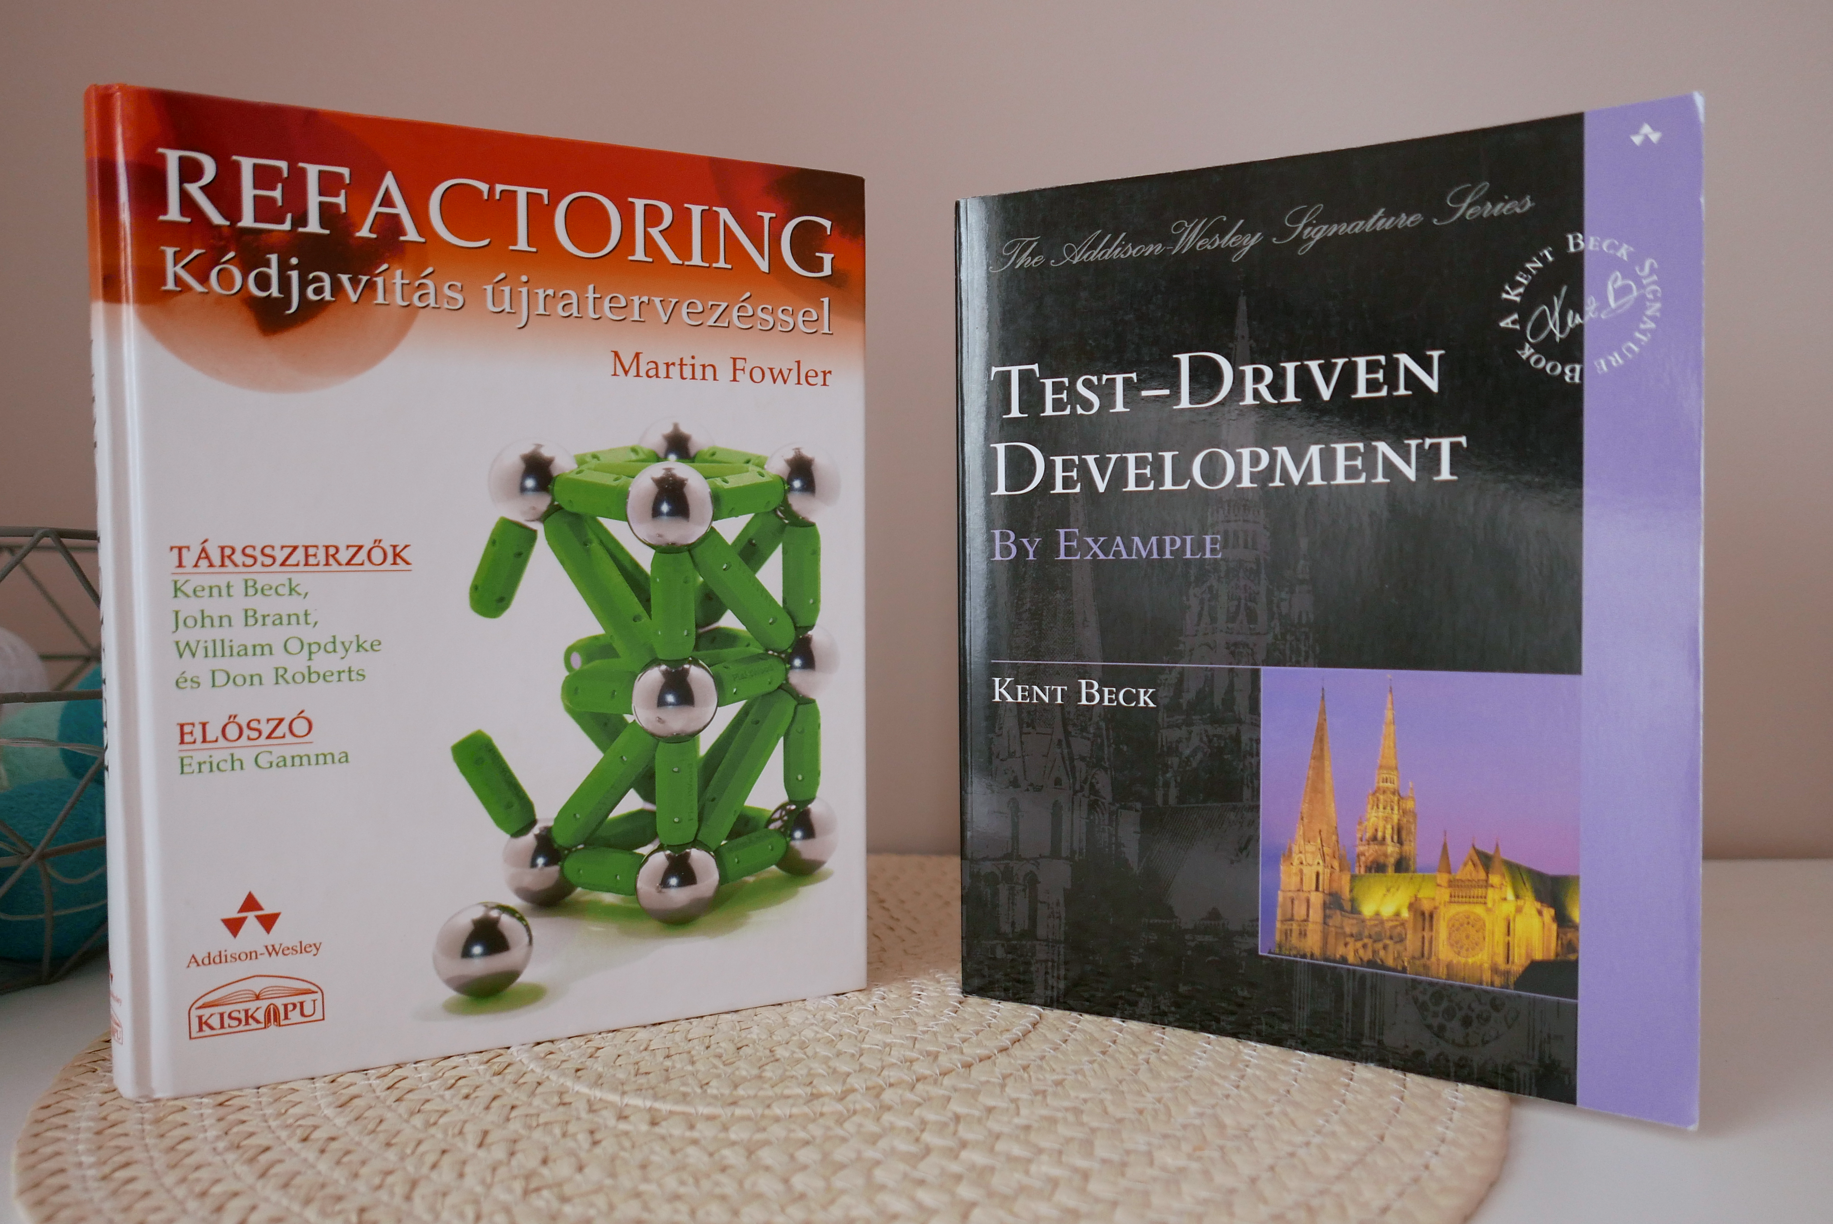

Slide 7
Being agile?

Slide 8
Thinking agile?

Slide 9
KANBAN
VS
SCRUM

Slide 10
continuous optimization
simplification
small iterations
small experiments
AGILE
baby steps
stabilization
Notes:
EXAMPLE: Refactoring & TDD are using these approaches

Slide 11
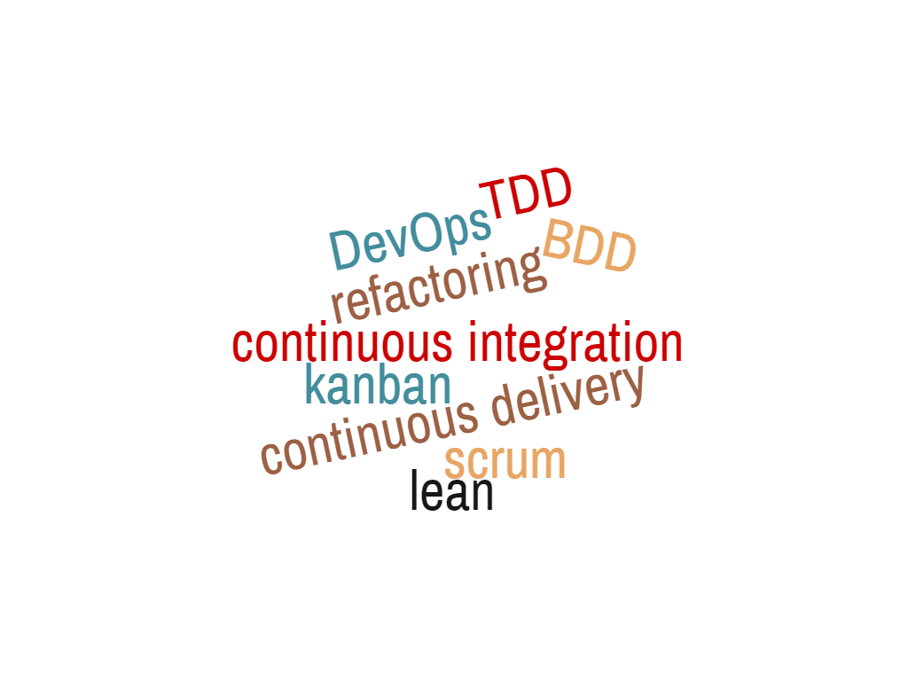
SAME APPROACH
Notes:
Word Cloud:
1 continuous~integration
1 continuous~delivery
1 refactoring
1 kanban
1 DevOps
1 scrum
1 lean
1 TDD
1 BDD

Slide 12
CI

Slide 13
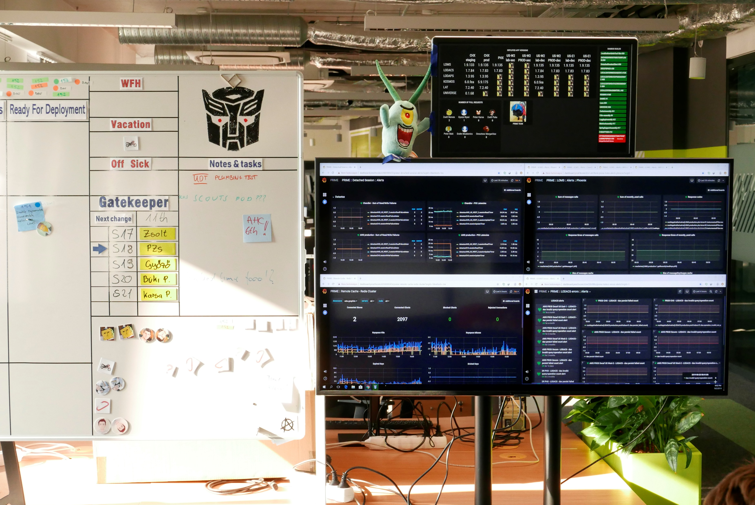
CI

Slide 14
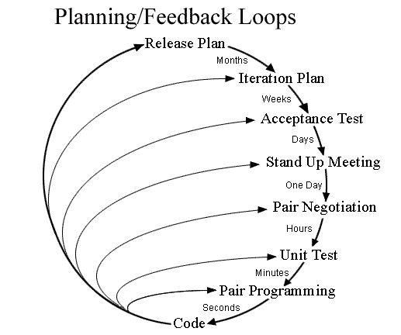

Slide 15
pipeline as code
living documentation
continuous testing
generators
containers
hotswap
code

Slide 16
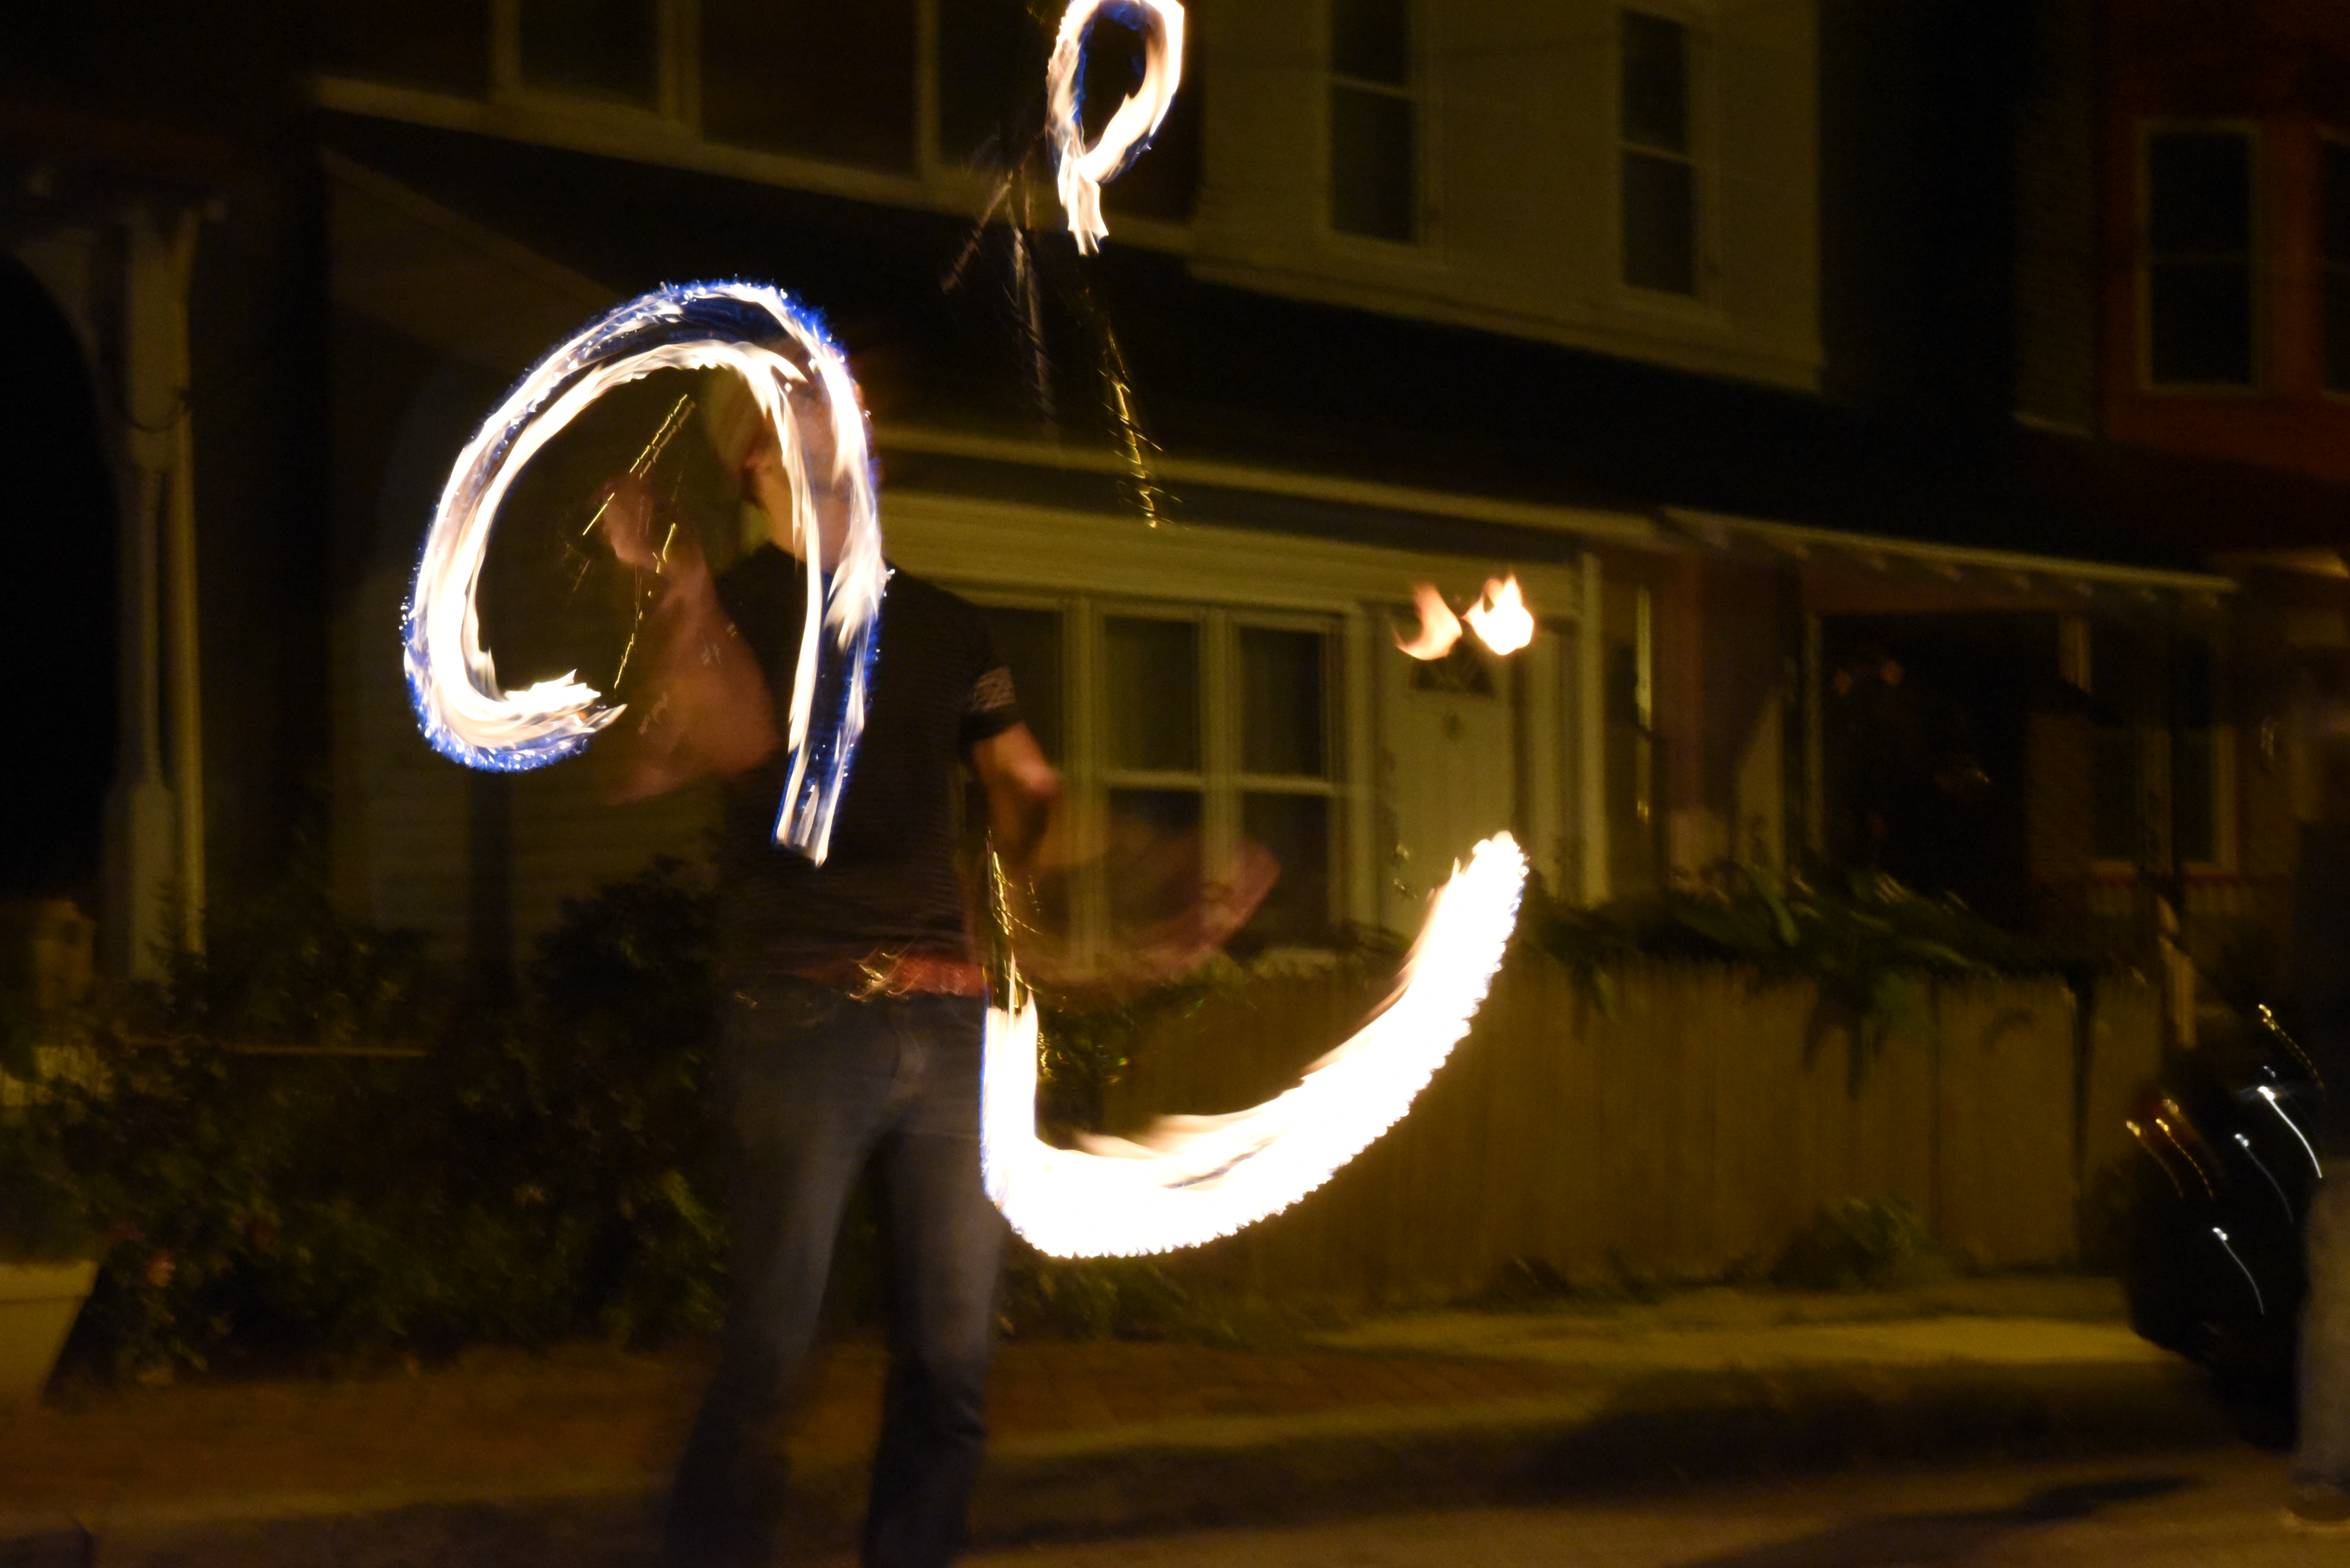
HOTSWAP

Slide 17
Ctrl+F9

Slide 18

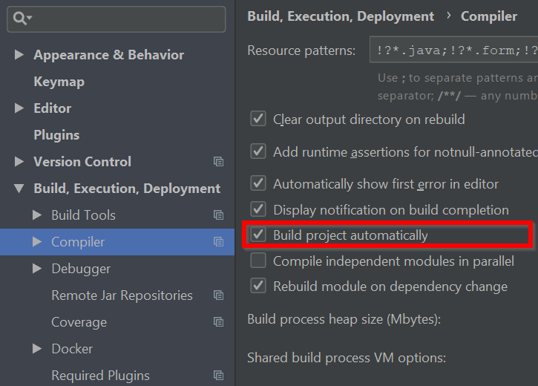

Slide 19
0 cost
1st thing to do
don’t block hotswap
hotswap the whole day

Slide 20

CONTAINERS

Slide 21
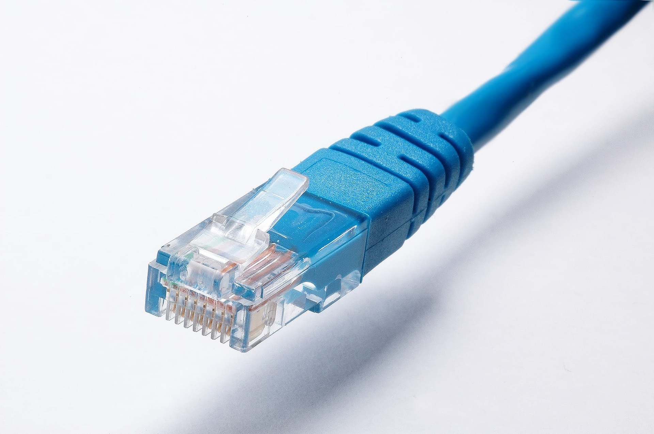

Slide 22





SAML 2.0
S3

Slide 23


VS

Slide 24
apiVersion: apps/v1
kind: Deployment
…
spec:
…
template:
spec:
containers:
- name: …
…
---
apiVersion: v1
kind: Service
metadata:
name: mysql
…
version: '3'
services:
toxiproxy:
image: "shopify/toxiproxy"
redis-master:
image: "redis:alpine"
redis-slave:
image: "redis:alpine"
mysql:
image: mysql:5.6
…

Slide 25
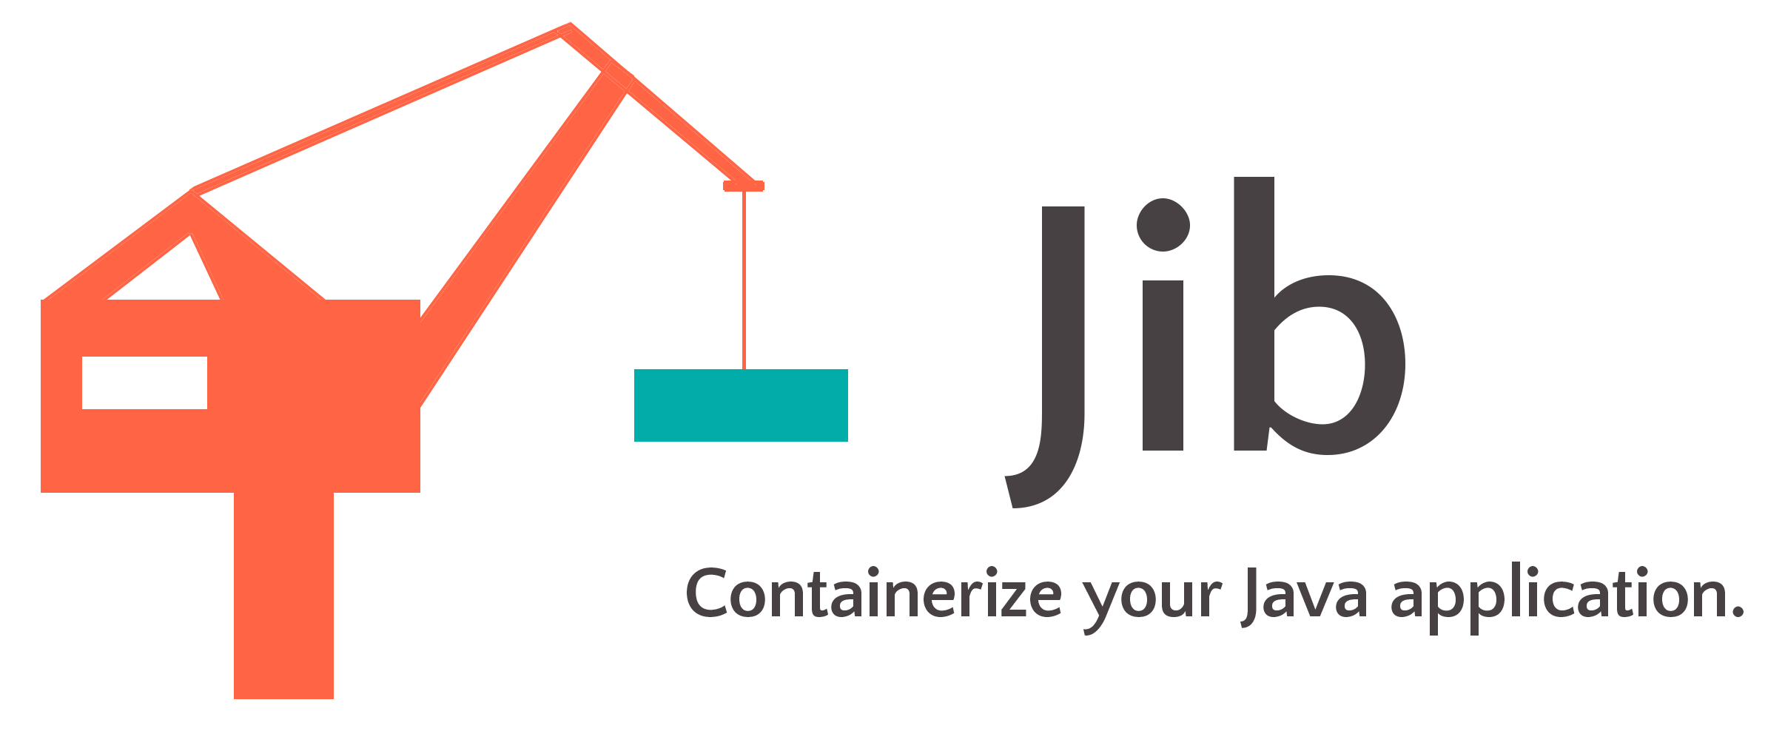


Slide 26

plugins { id 'com.google.cloud.tools.jib' version '1.4.0’ }
./gradlew jibDockerBuild \
--image=agile-springboot:latest

Slide 27
apiVersion: skaffold/v1beta13 kind: Config build: artifacts: - image: agile-springboot deploy: kubectl: manifests: - src\main\kubernetes\agile-springboot.yml - src\main\kubernetes\mysql.yml
eval $(minikube env)
skaffold init
skaffold dev

Slide 28
fastest orchestrator locally
use embedded dependencies if needed
don’t depend on your orchestrator
dependencies living documentation
don’t block hotswappin’

Slide 29
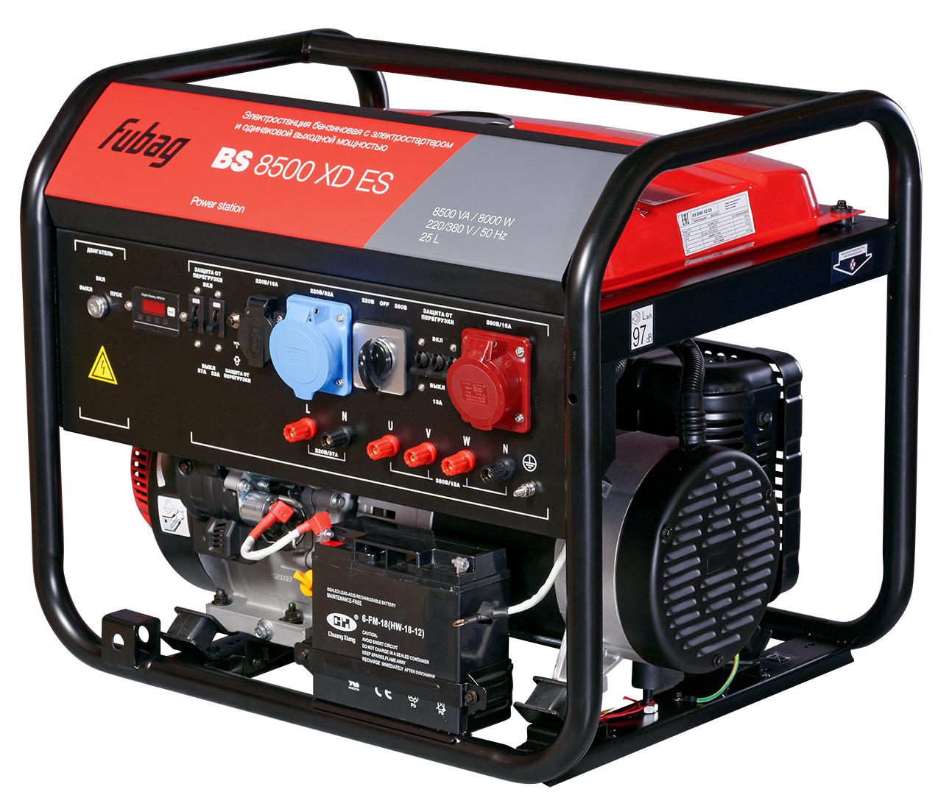
GENERATORS

